Slide 1
Balanced Incomplete Block Design(BIBD)
April 17 2018

Slide 2
Revisit RCBD
Suppose that there are a treatments (factor levels) and b blocks
A statistical model (effects model) for the RCBD is
μ is an overall mean, τ_{i} is the effect of the ith treatment, and β_{j} is the effect of the jth block
ε_{ij} ~ NID(0,σ²)

Slide 3
Means model for the RCBD
The relevant (fixed effects) hypotheses are
An equivalent way for the above hypothesis
Notations:

Slide 4
ANOVA partitioning of total variability:

Slide 5
SS_{T} = SS_{Treatment} + SS_{Blocks} + SS_{E}
Total N = ab observations, SS_{T} has N – 1 degrees of freedom.
a treatments and b blocks, SS_{Treatment} and SS_{Blocks} have a – 1 and b – 1 degrees of freedom.
SS_{E} has ab – 1 – (a – 1) – (b – 1) = (a – 1)(b – 1) degrees of freedom.
SS_{Treatment} /σ², SS_{Blocks} / σ² and SS_{E} / σ² are independently chi-square distributions.

Slide 6
The expected values of mean squares:
For testing the equality of treatment means,

Slide 7
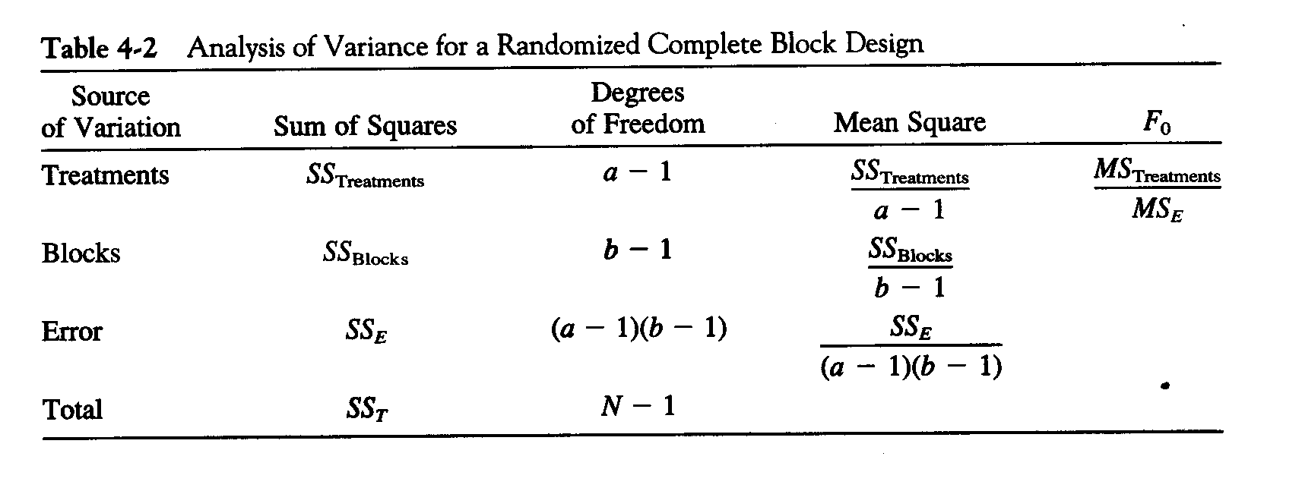
The ANOVA table
Another computing formulas:

Slide 8
Incomplete Block Designs
May not run all the treatment combinations in each block
The within block variability generally increases with block size
Any two treatments appear together an equal number of λ times
There are a treatments and each block can hold exactly k (k < a) treatments
The design is called an Incomplete Block Design
Example
Block
1 2 3 4
A A A B
B B C C
C D D D
Verify that λ=2

Slide 9
BIBD Definition
An incomplete design is said to be a Balanced Incomplete Block Design.
if all treatments appear in exactly r blocks.
This ensures that each treatment is estimated with the same precision
The value of λ is the same for each treatment pair.
if all treatment pairs i and i* appear together in exactly λ blocks.
This ensures that each treatment difference is estimated with the same precision.
The value of λ is the same for each treatment pair.

Slide 10
Some BIBD Identities
Let b = the number of blocks.
a= the number of treatments
k = the block size
r = the number of times a treatment appears in the experiment.
λ = the number of times a pair of treatment appears together in the same block
bk = ra
Both sides of this equation are found by counting the total number of experimental units in the experiment.
r(k-1) = λ (a – 1)
Both sides of this equation are found by counting the total number of experimental units that appear with a specific treatment in the experiment.

Slide 11
Statistical Analysis of the BIBD
a treatments and b blocks. Each block contains k treatments, and each treatment occurs r times. There are N = ar = bk total observations. The number of times each pairs of treatments appears in the same block is
The statistical model for the BIBD is

Slide 12
The sum of squares

Slide 13
The degree of freedom:
Treatments(adjusted): a – 1
Error: N – a – b – 1
The testing statistic for testing equality of the treatment effects:
ANOVA table

Slide 14
Least Squares Estimation of the Parameters
The least squares normal equations:
Under the constrains,
we have

Slide 15
For the treatment effects,

Slide 16
An Example
A food processing company is interested in comparing the taste of six new brands (A, B, C, D, E and F) of cereal.
For this purpose:
subjects will be asked to taste and compare these cereals scoring them on a scale of 0 - 100.
For practical reasons it is decided that each subject should be asked to taste and compare at most four of the six cereals.
For this reason it is decided to use b = 15 subjects and a balanced incomplete block design to assess the differences in taste of the six brands of cereal.

Slide 17
The design and the data is tabulated below:
What is (a, b, k, r, λ)?

Slide 18
The SAS Code for BIBD
filename input '/folders/myshortcuts/Math318/my_download/BIBDTASTE.txt'; data BIBDTASTE; infile input missover firstobs=2 dlm='09'x; input subject trt $ score; cards; proc glm data=bibdtaste; class subject trt; model score = subject trt /solution; random subject; lsmeans trt / adjust=tukey e cl lines pdiff; run; proc mixed data=bibdtaste covtest; class subject trt; model score = trt; random subject; lsmeans trt/ pdiff cl e adjust=tukey; run;

Slide 19
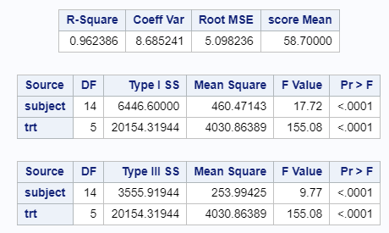
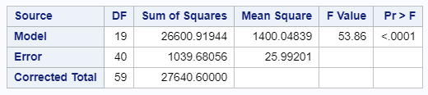
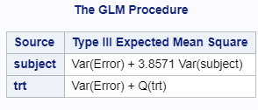
Anova Table for Incomplete Block Designs

Slide 20
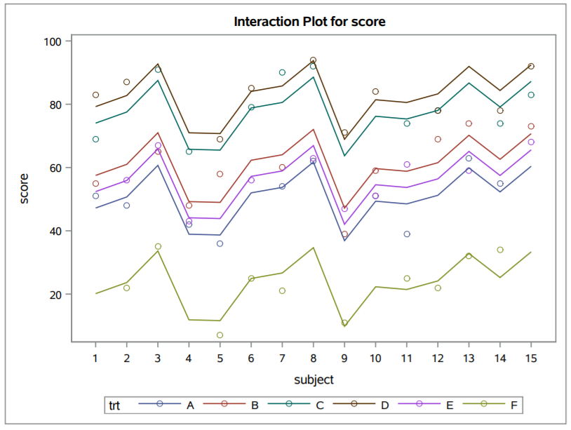
Interaction Plot

